Slide 1

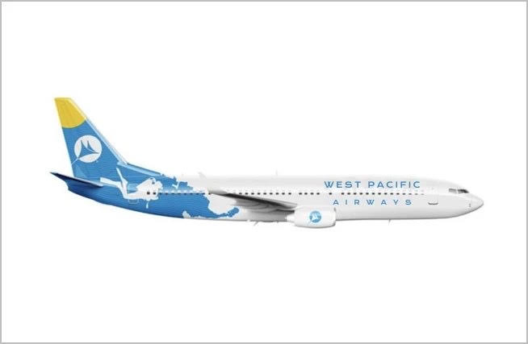


West Pacific Airways
Headquartered in Korea
Registered in Republic of Palau

Slide 2

PALAU AIRLINES d.b.a. West Pacific Air
PALAU AIRLINES AND WEST PACIFIC AIR is the registered trademarks of Airlines of the Republic of Palau

Slide 3
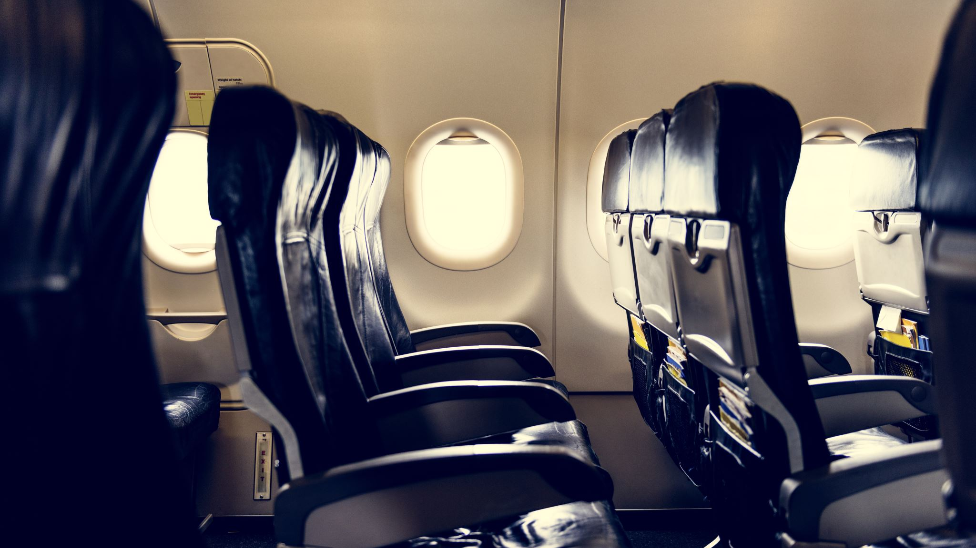
PALAU AIRLINES
Registered in Republic of Palau
AIR SERVICES will begin at 2nd half of 2026
First destinations will be incheon Airport in Seoul, Korea
Tokyo Narita and Taipei will follow
Cairns, Singapre, Manila & Guam will be added later
AIR SERVICE WILL START IN 2ND HALF OF 2026

Slide 4
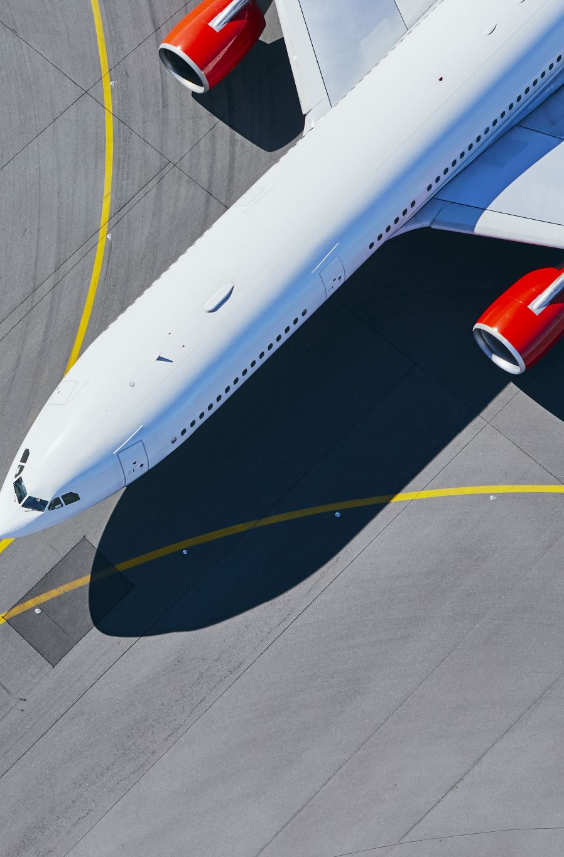
PALAU AIRLINES
MID TERM PLAN
Will start as a Full-Service Carrier with Business Class
Will actively seek Code-sharing with other airlines
Runway extension or building a new airport in Babeldaob will enable us to utilize widebody aircrafts
Incheon Airport will be our 2nd Hub by 2030

Slide 5
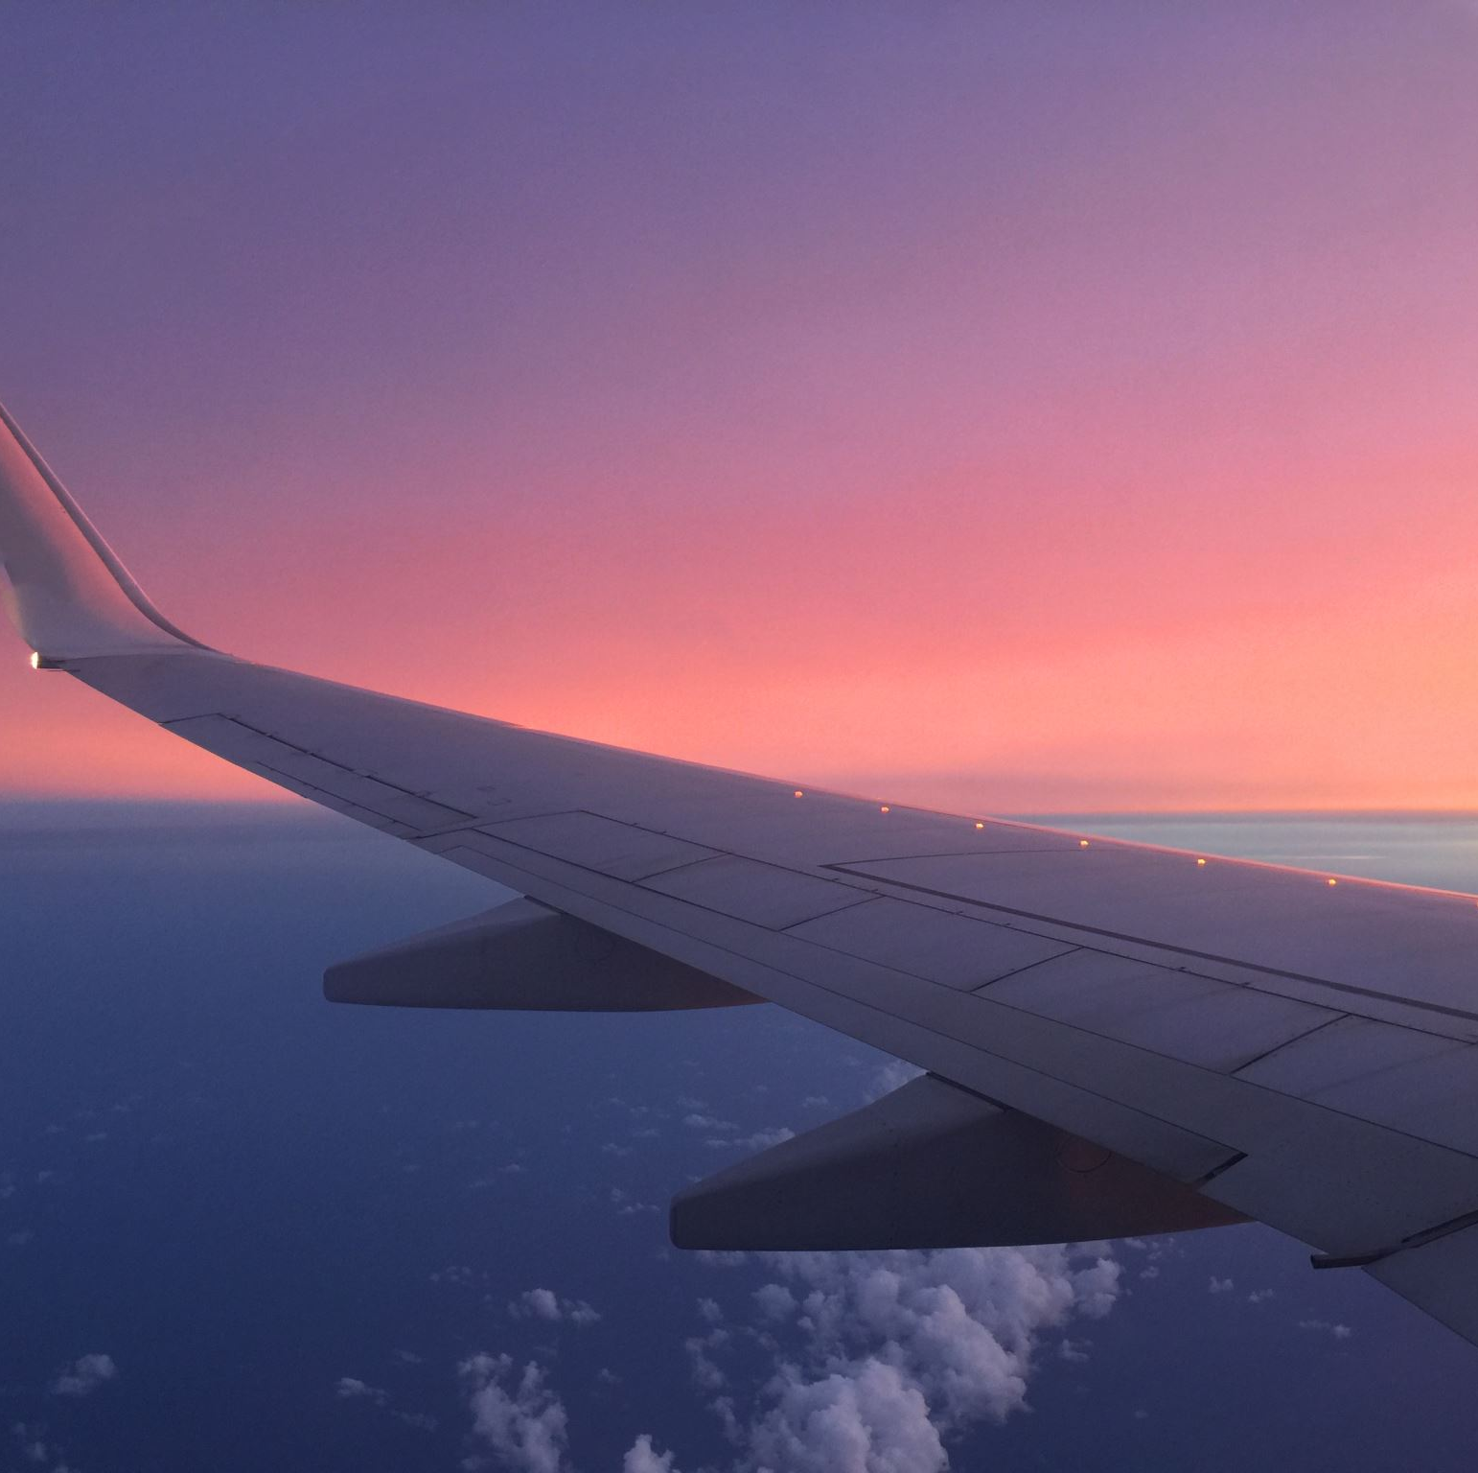
PALAU AIRLINES
FOR PASSENGERS FROM AMERICAS OR EUROPE
YOU MAY FLY TO KOREA FROM VARIOUS POINTS IN AMERICAS OR EUROPE VIA ANY AIRLINES FLYING INTO SEOUL- INCHEON AIRPORT
THEN YOU CAN TRANSFER TO PALAU AIRLINES FLIGHTS GOING DIRECT TO PALAU
FOR YOUR CONVENIENCE, WE WILL SOON CODESHARE WITH ONE OR TWO OF THE LONGHAUL CARRIERS

Slide 6
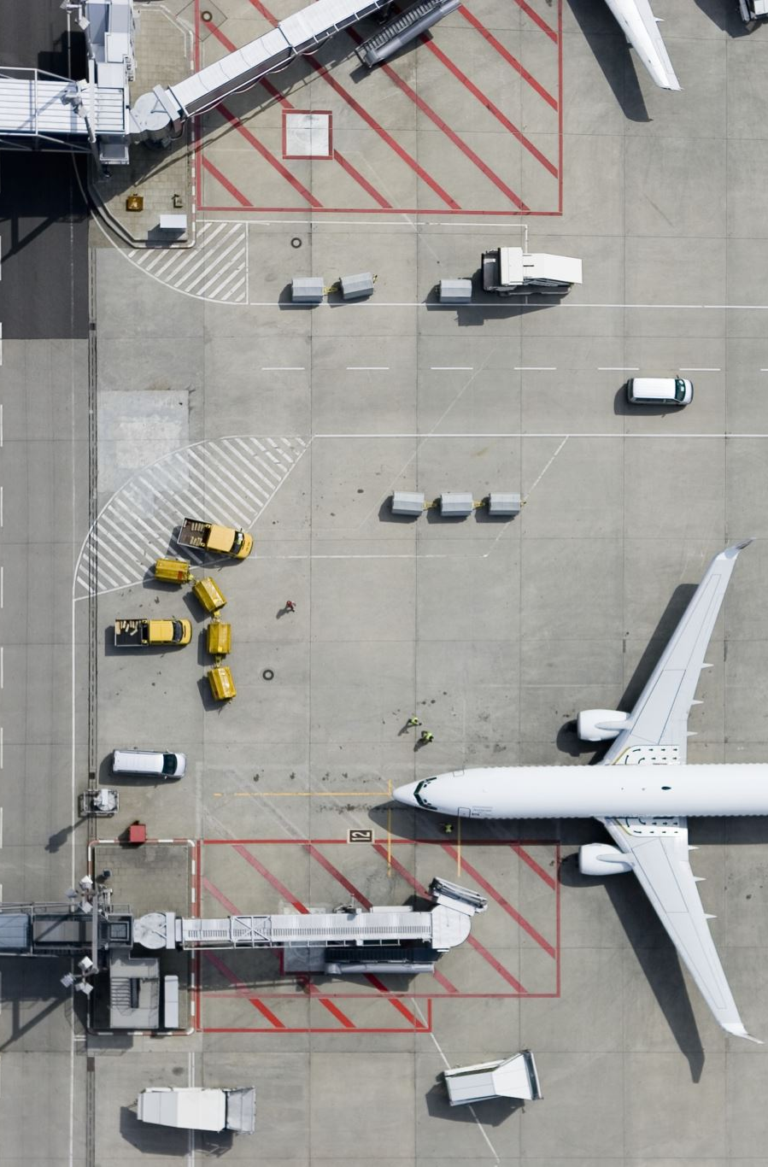
PALAU AIRLINES
FOR PASSENGERS FROM VARIOUS CITIES IN THE SOUTH EAST AISA, CHINA OR RUSSIA
YOU MAY TRANSFER FLIGHTS AT SEOUL INCHEON, TOKYO NARITA, OR TAIPEI GOING INTO PALAU
WE WILL ALSO BEGIN CODEESHARING WITH VARIOUS ASIAN CARRIERS

Slide 7

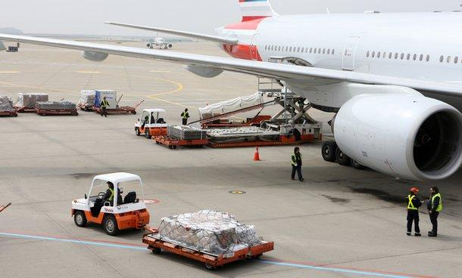



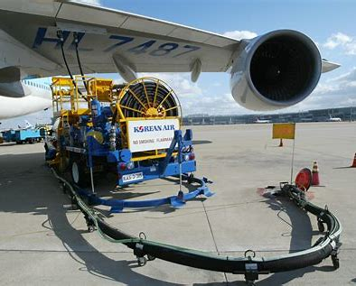
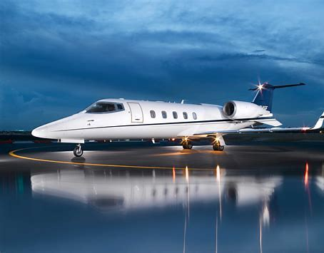
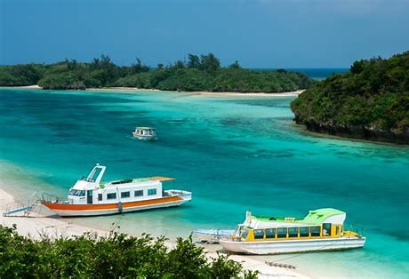

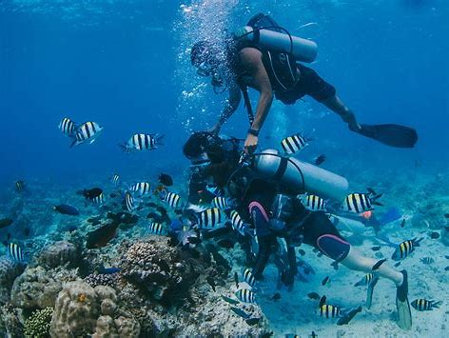


Miscellinous Services in Palau
Miscellaneous Business
to Explore
Ground Handling
Maintenance Services
In-Flight Meal Services
Private Jet Services
Private Jet & Chartered Services
Boat Tour
Refueling
Skin Scuba
Zipline
Jungle Jeep Tour

